Slide 1
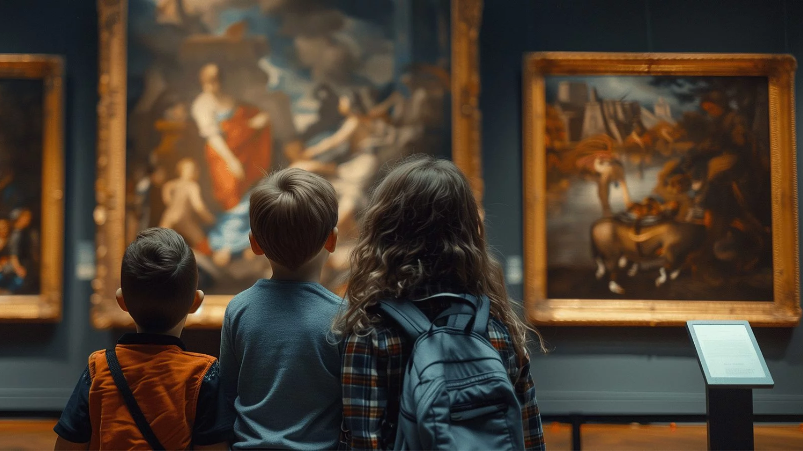
Talking Pictures
A picture says more
than a thousand words

Slide 2
OUR MISSION
OUR VISION
revolutionize museum visits
artworks answer visitor questions directly
personalized and interactive learning experience
enrich the visitor’s understanding and connection with the exhibit
Curators provide information, AI reformulates that information
AI will not replace people (experts, curtators, museum staff, guides etc.). It is however, an amazing piece of technology that will elevate museum experiences.
www.lean-mean-learning-machine.com

Slide 3
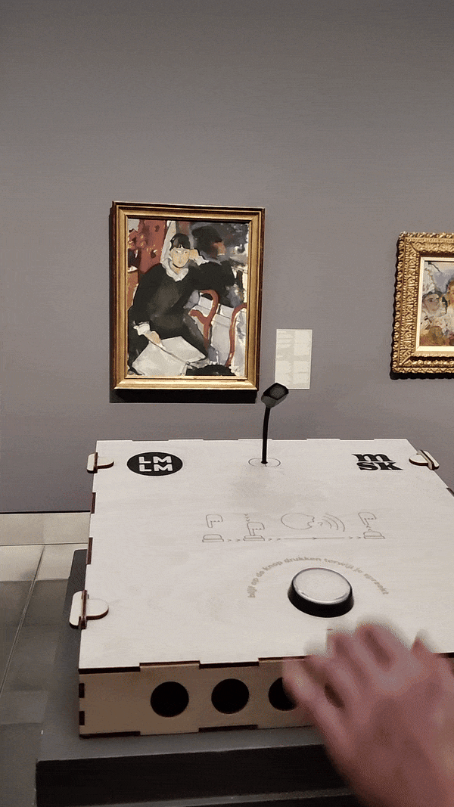
How it works
Press a button
Ask a question
Get an expert answer
Start a conversation!
Thanks to AI !

Slide 4
LMLM spotlight: Talking Pictures
dec 2023
‹#›

Slide 5
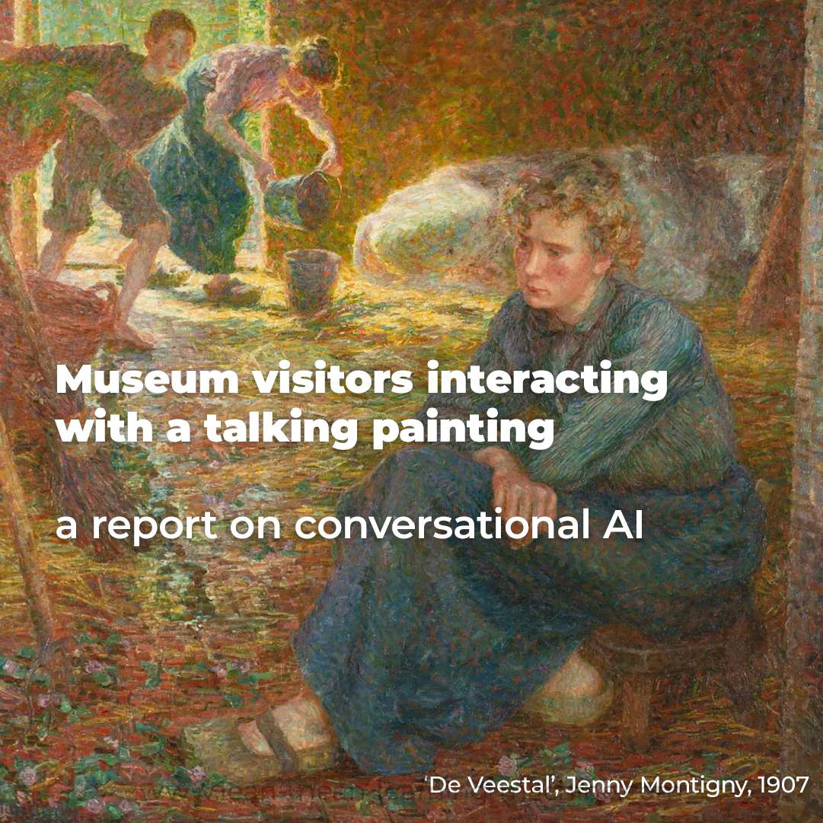
Case study
The Museum of Fine Arts in Ghent Belgium wanted to
improve visitor engagement
innovate with cutting edge technology
have an eye catcher for the ‘museum night’: an event where all museums in the city are open until midnight.

Slide 6
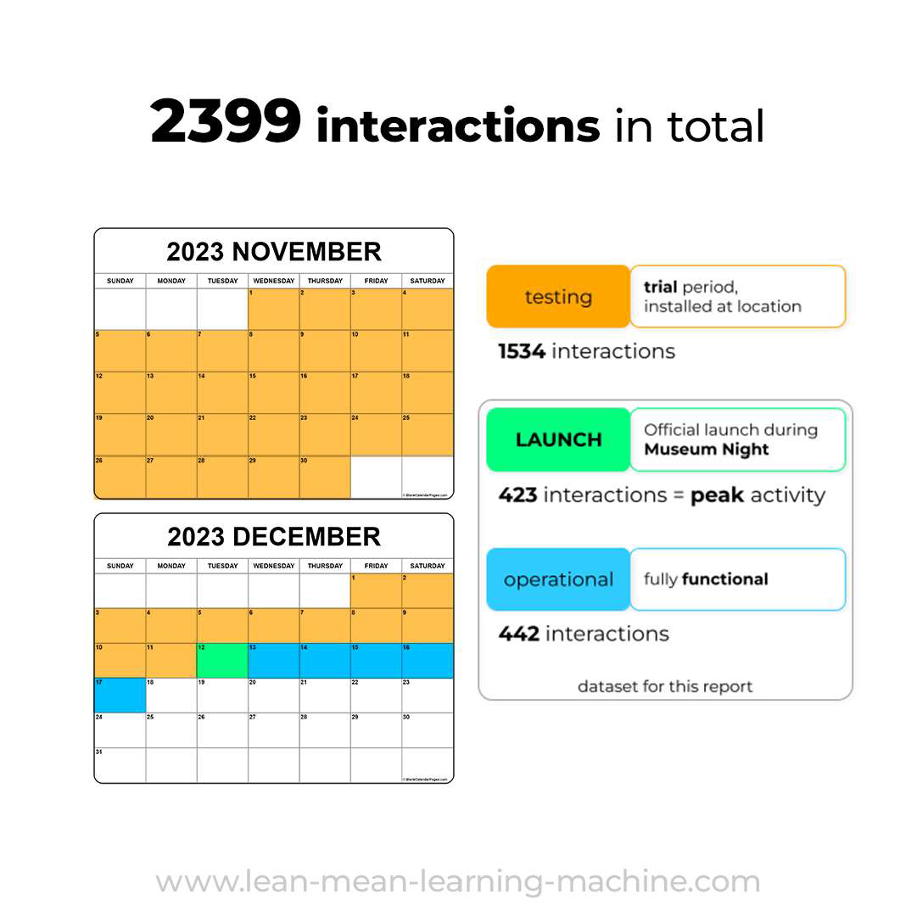
Case study
solution: start with 1 paintings that can engage with visitors: Jenny Montigny’s ‘The Cattle Shed’
and launch after a trial period with thorough testing of AI.

Slide 7
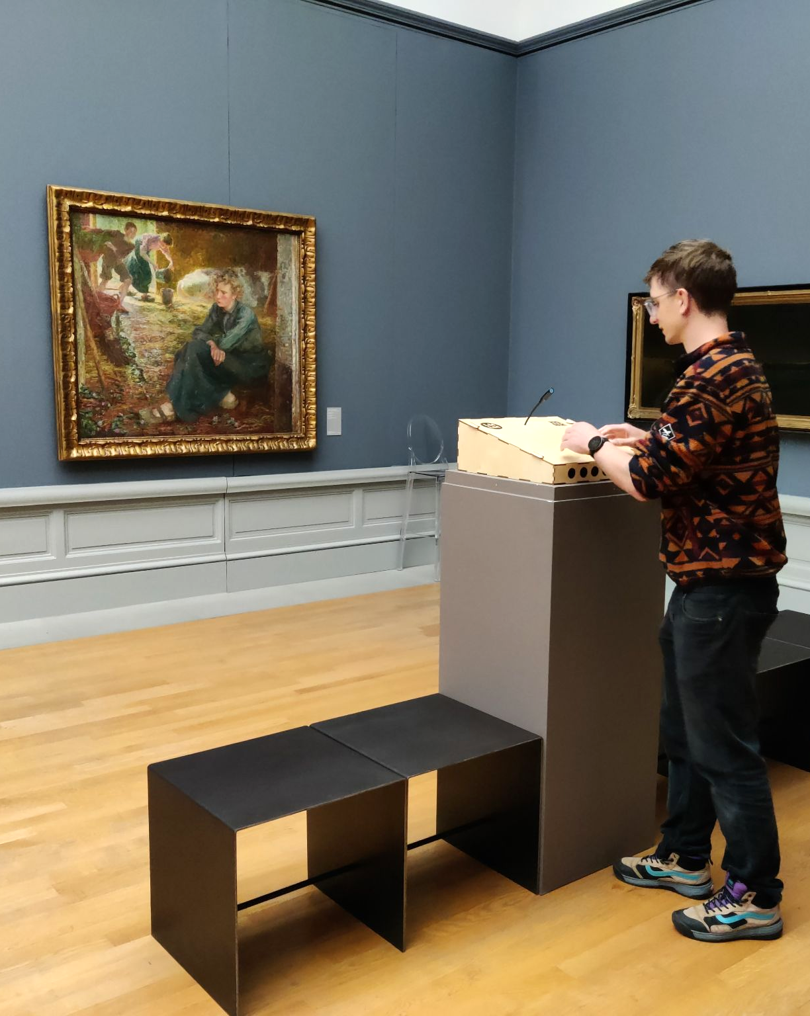
Case study: results
installed on location
2600 interactions in 30 days
new visitor insights
95% positive visitor reviews
news broadcasts on big TV networks
new roll-out in 2024
+500 interactions on event night

Slide 8
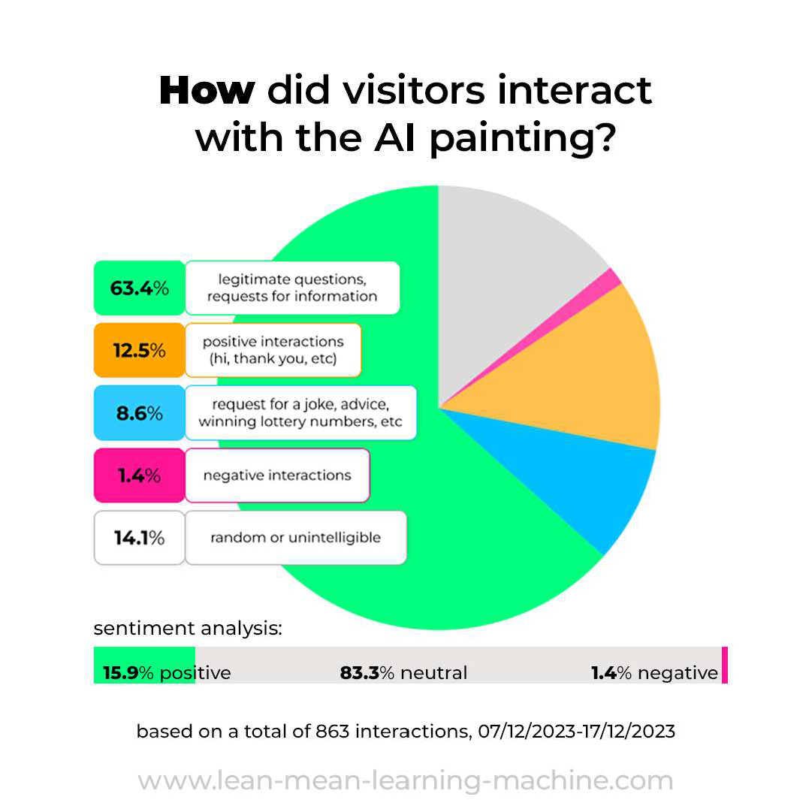
Case study
Analysis of log files revealed information that took everyone by surprise.
The museum now has a better understanding of what visitors are looking for and what type of information people are interested in.

Slide 9
Case study
Key takeaways
Visitors have questions about what is visible on the painting more than the technical aspects like the art style..
Questions are asked directly at the person on the paintings, not a third person. For example, visitors ask ‘why are you wearing those shoes’ and not ‘what shoes is she wearing’.
In our research of more than 2000 interactions, the AI was 99% accurate for the information she was trained on. If the AI didn’t know the answer, she simply said so.
The information the AI has comes from the curators. All the AI does is reformulate and summarize existing information. The AI rarely ‘hallucinates’ new information.

Slide 10
Case study
Visitor impressions of ‘Talking Pictures’ at the Museum of Fine Arts during the Museum Night Event

Slide 11
Does it speak my language?
Below are the available languages
Arabic 🇸🇦
Basque 🇪🇸
Bengali 🇧🇩
Bulgarian 🇧🇬
Catalan 🇪🇸
Chinese 🇨🇳
Czech 🇨🇿
Danish 🇩🇰
Dutch 🇳🇱
English 🇬🇧
Finnish 🇫🇮
French 🇫🇷
Galician 🇪🇸
German 🇩🇪
Greek 🇬🇷
Gujarati 🇮🇳
Hindi 🇮🇳
Hungarian 🇭🇺
Indonesian 🇮🇩
Italian 🇮🇹
Japanese 🇯🇵
Kannada 🇮🇳
Korean 🇰🇷
Latvian 🇱🇻
Lithuanian 🇱🇹
Malay 🇲🇾
Marathi 🇮🇳
Polish 🇵🇱
Portuguese 🇵🇹
Punjabi 🇮🇳
Romanian 🇷🇴
Russian 🇷🇺
Serbian 🇷🇸
Slovak 🇸🇰
Ukrainian 🇺🇦
Vietnamese 🇻🇳

Slide 12
Pricing
Prices typically range between €2,000 and €4,000 per installation.
3 factors impacting price point:
complexity of prompt: more information requires more testing and iterations
encasing: choose our custom encasings, or supply your own
customization: specific voice, multi-language options, reporting etc
inquire about our options

Slide 13
Procedure - steps in the process
concept
testing
training
installation
on-site
launch
follow-up
development
testing

Slide 14
Procedure - what YOU do
decide what/where/how
provide expert info*
ensure WIFI or Ethernet
test the installation
get the word out
concept
testing
1
2
4
training
3
installation
on-site
launch
follow-up
development
5
*We closely work together with your curators and subject matter experts to ensure all information is 100% correct.
testing

Slide 15
Procedure - what WE do
train the AI
provide software and hardware
create casing (optional)
internal testing
installation
create log files and reports
concept
testing
training
installation
on-site
launch
follow-up
development
5
6
1
2
3
testing
4

Slide 16
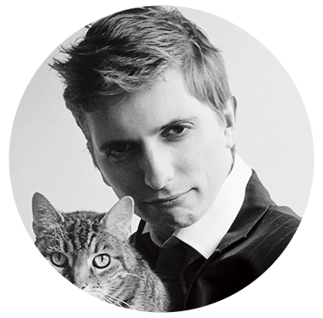
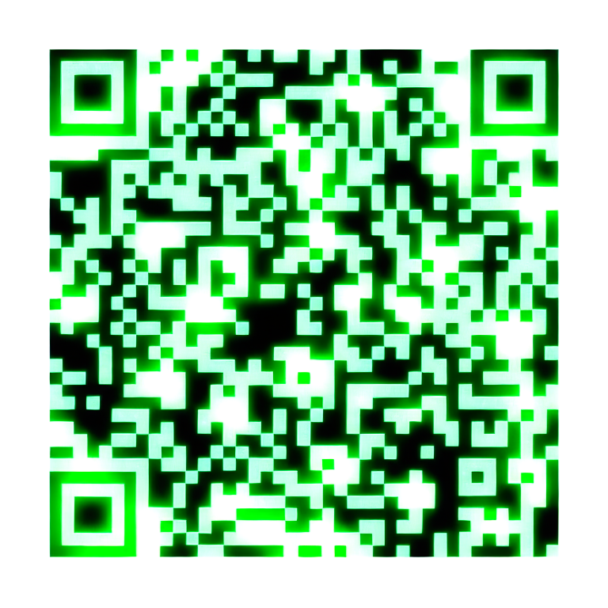
Next step? Contact us
Dennis Lippens
(+32 ) 484 97 22 57
dennis@Lean-Mean-Learning-Machine.com

